Slide 1
Cryptographic coprocessor
Tomáš Davidovič
16. 6. 2008

Slide 2
Introduction
Asymmetric cryptography
RSA – Integer factorization
ECC – Elliptic Curve Cryptography
Points on an Elliptic Curve
Basic operation – scalar point multiplication
Q = k*P – compute via add-and-double
ECDLP – Elliptic Curve Discrete Logarithm Problem, determine k from Q and P

Slide 3
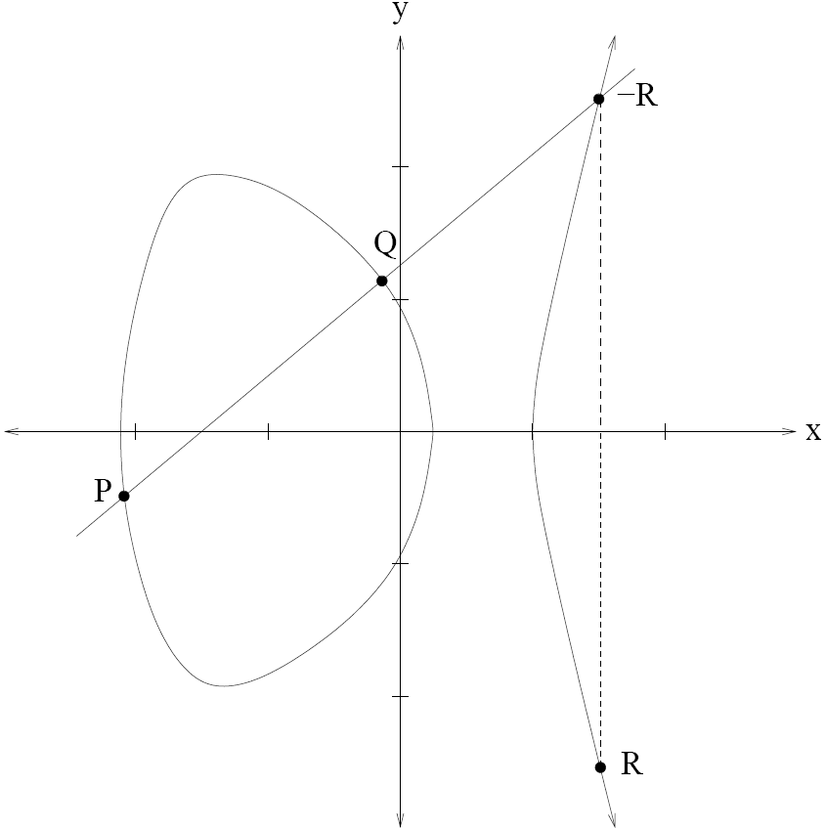
EC – point addition – real numbers

Slide 4
EC – discrete
Cannot use real numbers
Coordinates from GF(2^{m})
Two coordinate systems
  Affine coordinates (x, y) – mul & div
  Projective coordinates (x, y, z) – mul only
Two bases in GF(2^{m})
  Polynomial – a_{m-1}x^{m-1}+a_{m-2}x^{m-2}+…+a₁x+a₀
  Normal – a_{m-1}x^{2^(m-1)}+a_{m-2}x^{2^(m-2)}+…+a₁x²+a₀x

Slide 5
EC – required operations
Addition, subtraction
  Bitwise XOR in both bases
Squaring
  Simple (but different) comb. logic in both
Multiplication
  Bit-serial (m cycles)
  Digit-serial multiplier in both (m/D cycles)
Division
  Polynomial b. via Extended Euclid’s Algorithm
  Normal b. via Little Fermat Theorem (costly)

Slide 6
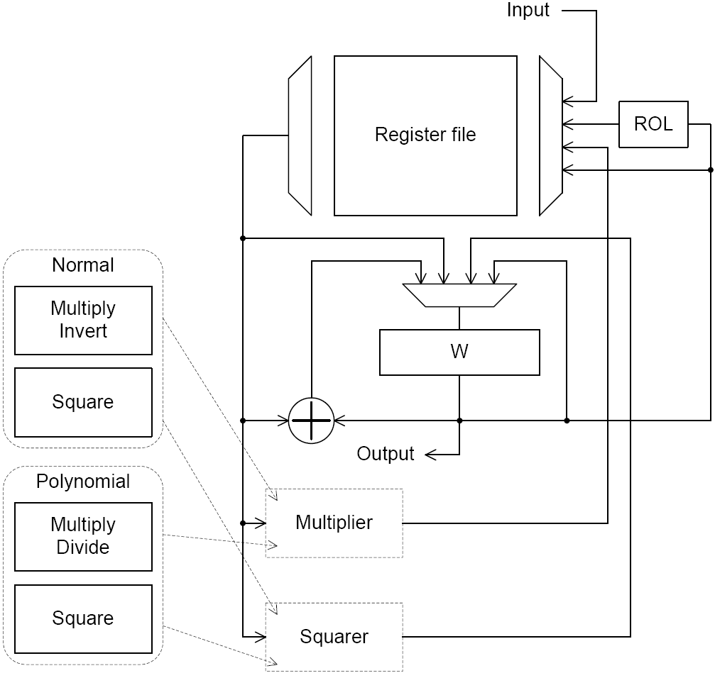
Block diagram
Previous work

Slide 7
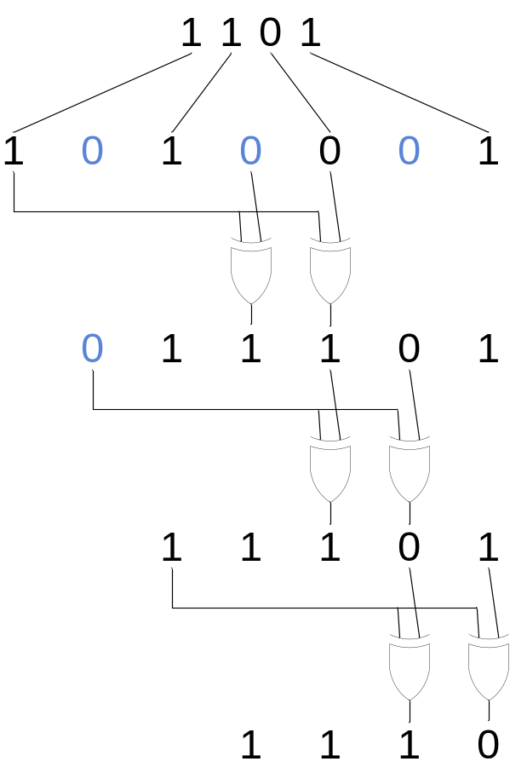
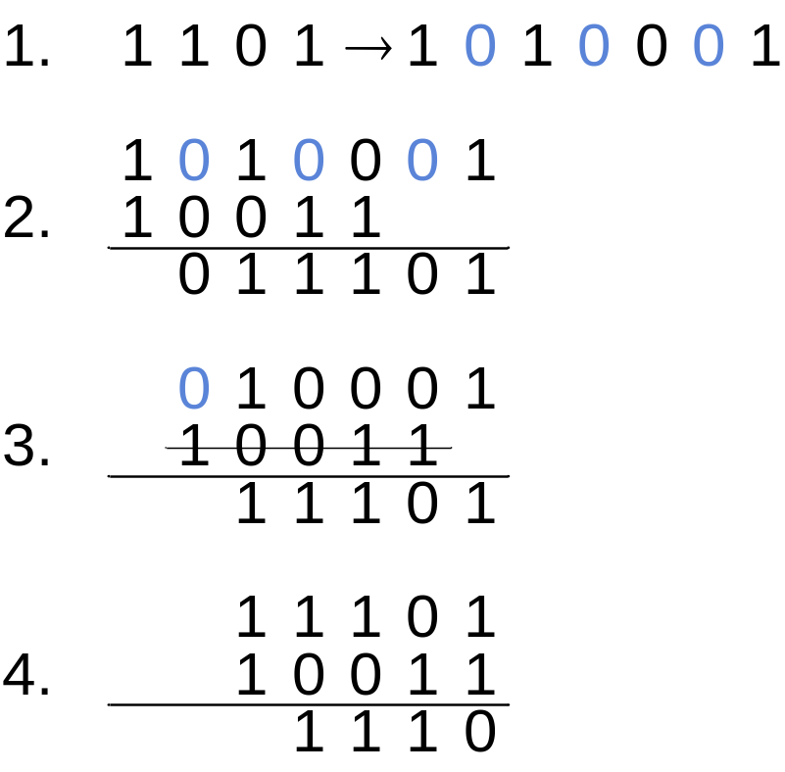
Polynomial squaring

Slide 8
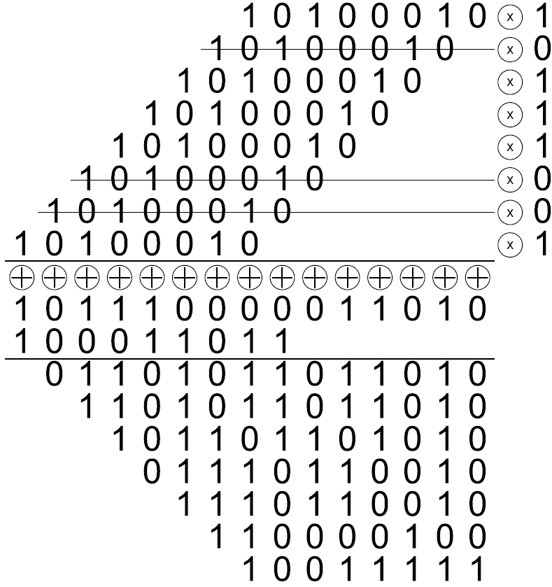
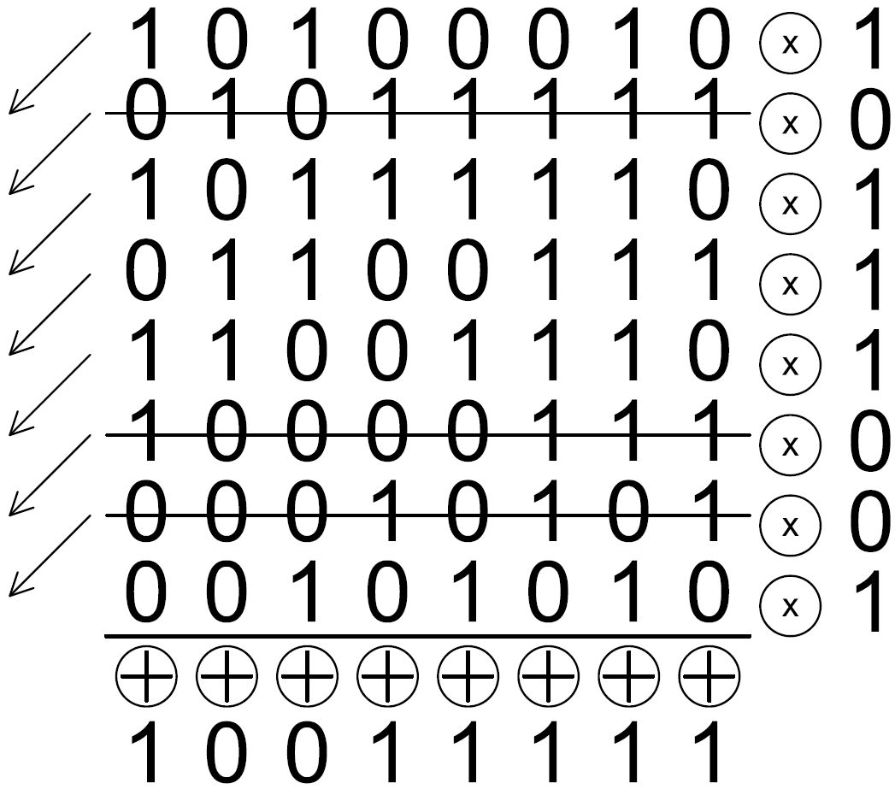
Multiplication – bit-serial

Slide 9
Multiplication – digit-serial
Bit-serial – C = A*B
  Multiplies by 1 bit at a time
Digit-serial – C = A*B;
  Digit – multiply by D bits at a time
  C = 0; i = 0; (D = 2)
  C = C + A*B[i] + (A<<1)*B[i+1]
  Shift A left by 2; i = i + 2; Repeat until i = m

Slide 10
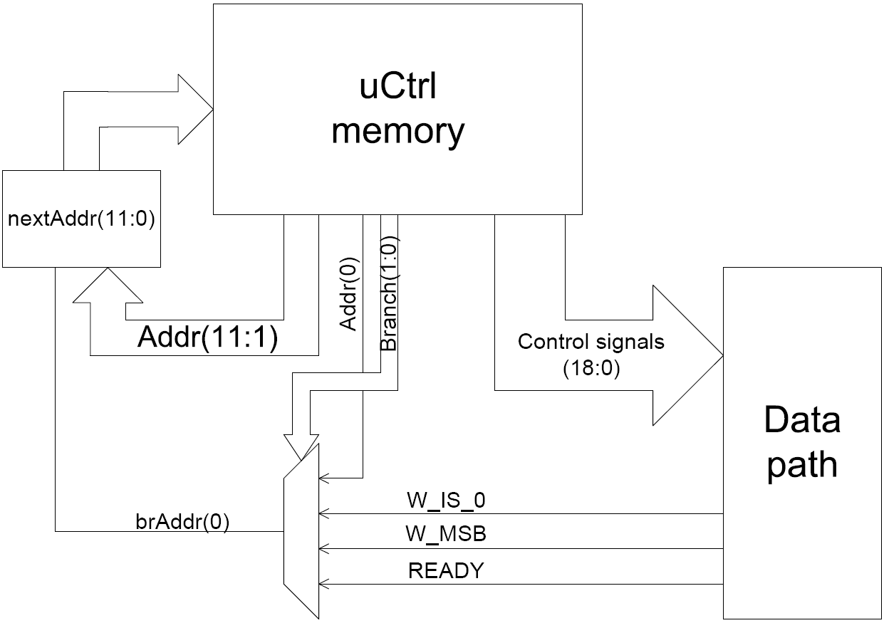
Micro-controller

Slide 11
Verification
Some functions base specific
  Wrappers
Algorithms universal
Test algorithms
Use algorithms to verify design
Quality – code coverage
  Statement coverage – each line used
  Branch coverage – each if taken both ways

Slide 12
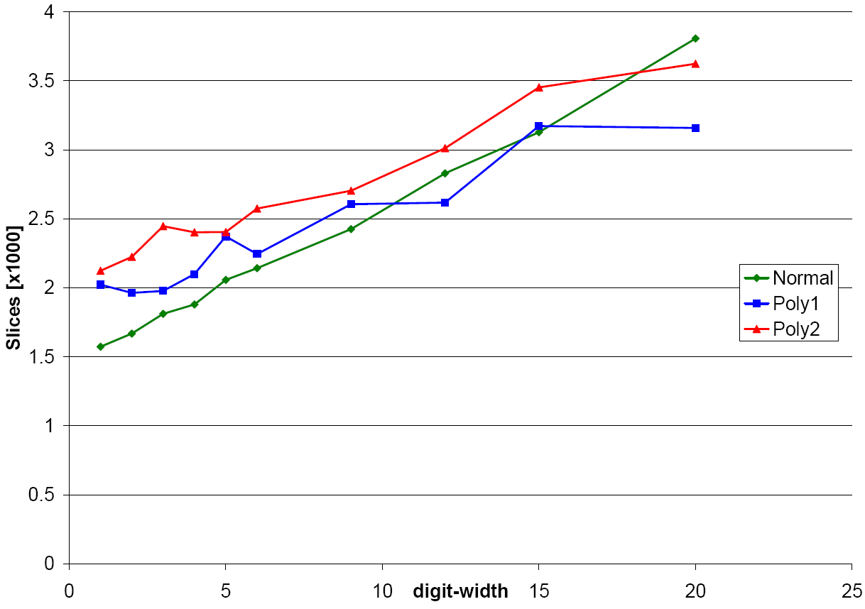
Results – area

Slide 13
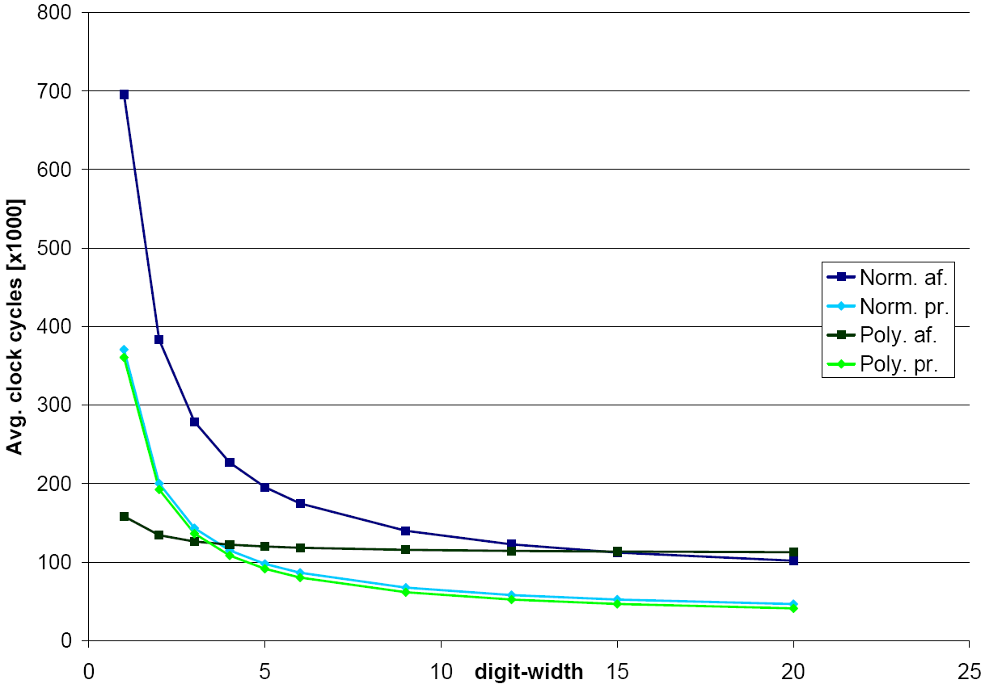
Results – speed (cycles)

Slide 14
Wrap Up
Coprocessor
  Both bases implemented
  Both coordinate systems evaluated
Verification
  100% Branch and statement coverage
  Everything passes
Comparison
  Normal D=6 and poly D=1 equal in size
  Normal faster than poly when equal size

